Slide 1
Severity-Based Stroke Triage: Key Concepts
Toby Gropen, MD, FAHA
Director, UAB Comprehensive
Neurovascular and Stroke Center

Slide 2
Course Description
This course is based on the premise that earlier identification of strokes will lead to earlier treatment and better outcomes.
Materials covered include:
Severity-Based Stroke Triage and why the Alabama Stroke System is incorporating it
Why it matters: Treatment options and time windows for acute ischemic stroke
Key Concepts:
Stroke versus Stroke mimics
Large vessel occlusion (LVO)
The Emergency Medical Stroke Assessment (EMSA)
Concept of time Last Known Well (LKW)

Slide 3
Learning Objectives
At the conclusion of this course, participants will be able to:
Understand why the Alabama Stroke System is incorporating severity-based stroke triage
Recall treatment options for ischemic strokes and the time frame for certain treatment options
Recognize stroke symptoms and signs and common stroke mimics
Examine a patient using the EMSA, and interpret the results
Determine a patient’s LKW time
Support patients in getting routed to the most suitable location avoiding delays

Slide 4
Current EMS Stroke Triage
Current Stroke Triage to nearest stroke center
Patient
EMS
Non-Stroke
Center
Stroke
Center

Slide 5
Stage 1: EMS Identification of Patients with Severe Stroke (Suspected LVO)
Patient
EMS
Non-Stroke
Center
Stroke
Center

Slide 6
Stage 1: EMS Identification of Patients with Severe Stroke (Suspected LVO)
Patient
Distinguish between Stroke and Stroke Mimic
EMS
Non-Stroke
Center
Stroke
Center

Slide 7
Stage 1: EMS Identification of Patients with Severe Stroke (Suspected LVO)
Patient
Distinguish between Stroke and Stroke Mimic
Distinguish between mild and severe stroke (suspected LVO)
EMS
Non-Stroke
Center
Stroke
Center

Slide 8
Stage 1: EMS Identification of Patients with Severe Stroke (Suspected LVO)
Patient
Distinguish between Stroke and Stroke Mimic
Distinguish between mild and severe stroke (suspected LVO)
Determine time LKW
EMS
Non-Stroke
Center
Stroke
Center

Slide 9
Stage 2: Severity-Based Stroke Triage
EMS Evaluation and Triage
AVPU = A or V
AND
Severe Stroke
AND
Time LKW < 24 hrs

Slide 10
Stage 2: Severity-Based Stroke Triage
EMS Evaluation and Triage
AVPU = A or V
AND
Severe Stroke
AND
Time LKW < 24 hrs
Standard Triage
No

Slide 11
Stage 2: Severity-Based Stroke Triage
EMS Evaluation and Triage
Severity Based Stroke Triage
AVPU = A or V
AND
Severe Stroke
AND
Time LKW < 24 hrs
Standard Triage
Yes
No

Slide 12
Stage 2: Severity-Based Stroke Triage
EMS Evaluation and Triage
Severity Based Stroke Triage
AVPU = A or V
AND
Severe Stroke
AND
Time LKW < 24 hrs
Standard Triage
Yes
No
Primary
triage
Thrombectomy
Capable
Stroke Center

Slide 13
Stage 2: Severity-Based Stroke Triage
EMS Evaluation and Triage
Severity Based Stroke Triage
AVPU = A or V
AND
Severe Stroke
AND
Time LKW < 24 hrs
Standard Triage
Yes
No
Primary
triage
Non-
Thrombectomy
Capable
Stroke Center
Thrombectomy
Capable
Stroke Center
Secondary triage

Slide 14
Stage 2: Severity-Based Stroke Triage
EMS Evaluation and Triage
Severity Based Stroke Triage
AVPU = A or V
AND
Severe Stroke
AND
Time LKW < 24 hrs
Standard Triage
Yes
No
Primary
triage
TCC
Non-
Thrombectomy
Capable
Stroke Center
Thrombectomy
Capable
Stroke Center
Secondary triage

Slide 15
5 Year Project Timeline
Region 3 | Statewide EMS training in EMSA | Statewide EMS training in EMSA |  |  |  | Standard Triage |  |  |  | Train | TCC Coordinated SBST
Region 5 |  |  |  |  |  | Standard Triage |  |  |  |  | Train | TCC Coordinated SBST
Region 1 |  |  |  |  |  | Standard Triage |  |  |  |  |  | Train | TCC Coordinated SBST
Region 6 |  |  |  |  |  | Standard Triage |  |  |  |  |  |  | Train | TCC Coordinated SBST
Region 2 |  |  |  |  |  | Standard Triage |  |  |  |  |  |  |  | Train | TCC Coordinated SBST
Region 4 |  |  |  |  |  | Standard Triage |  |  |  |  |  |  |  |  | Train | TCC Coordinated SBST
Year | One |  |  |  | Two |  |  |  | Three |  |  |  |  | Four |  |  |  | Five
Quarter | 1 | 2 | 3 | 4 | 5 | 6 | 7 | 8 | 9 |  | 10 | 11 | 12 | 13 | 14 | 15 | 16 | 17 | 18 | 19 | 20
Standard triage: TCC Guided EMSA but with continued triage to nearest stroke center of any level
During standard triage period, we will develop region and hospital specific severity-based triage plans
Train: Implementation of region and hospital specific triage plans
TCC Coordinated SBST: TCC Guided EMSA and TCC Coordinated SBST

Slide 16
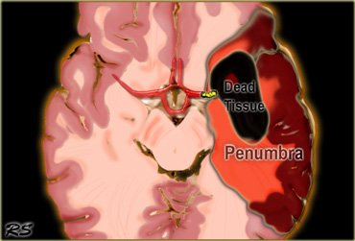
Why it Matters
Some of the damage may be reversible
Ischemic Core = Infarction = Irreversible tissue injury
Ischemic Penumbra = reduced blood supply = tissue at risk = potentially reversible

Slide 17
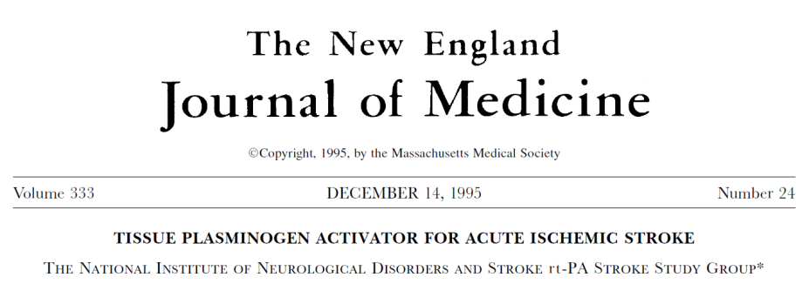
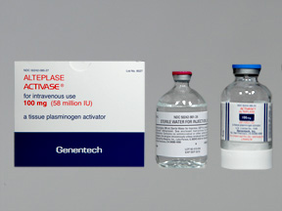
T-PA
Tissue Plasminogen Activator (t-PA) was approved by the FDA based on the 1995 NINDS rt-PA study
Clinical trial of IV t-PA vs. placebo given within 3 hours of onset
Patients treated with t-PA were 30% more likely to have minimal or no disability at three months
Additional studies have supported the use of t-PA up to 4.5 hours in selected patients
Advantages of t-PA; important contraindications

Slide 18
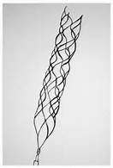
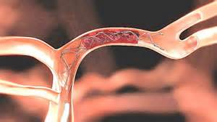
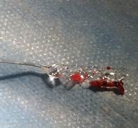
Intra-arterial Therapy for Stroke
Select stroke patients may be eligible for intra-arterial (IA) reperfusion therapies
Several clinical trials emerged since late 2014 showing benefit of mechanical thrombectomy in addition to t-PA for selected stroke patients with large vessel occlusions up to 24 hours after onset

Slide 19
The typical patient will lose 2 Million neurons each minute a stroke is not treated

Slide 20
Common Clinical Features of Stroke
Sudden onset + focal symptoms
Sudden unilateral facial droop
Sudden unilateral weakness or numbness
Sudden loss of vision
Sudden difficulty speaking and/or understanding
Sudden eye deviation and/or neglect of one-side

Slide 21
Stroke Mimics
Loss of consciousness without unilateral symptoms
Seizure
Syncope
Altered mental status without unilateral symptoms
Hypotension
Hypoglycemia
Overdose
Pain
Migraine
Arm or leg pain

Slide 22
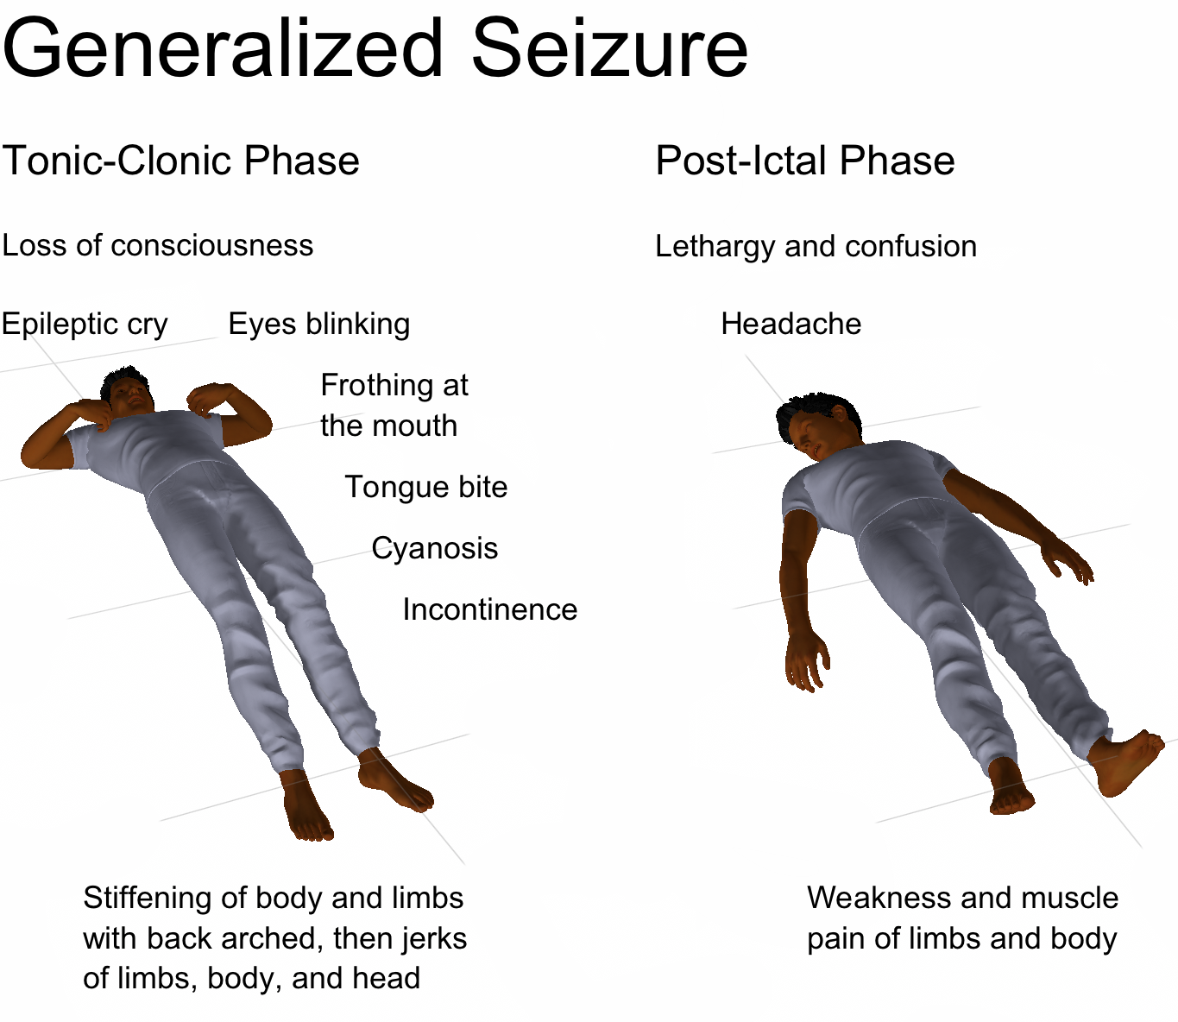

Slide 23
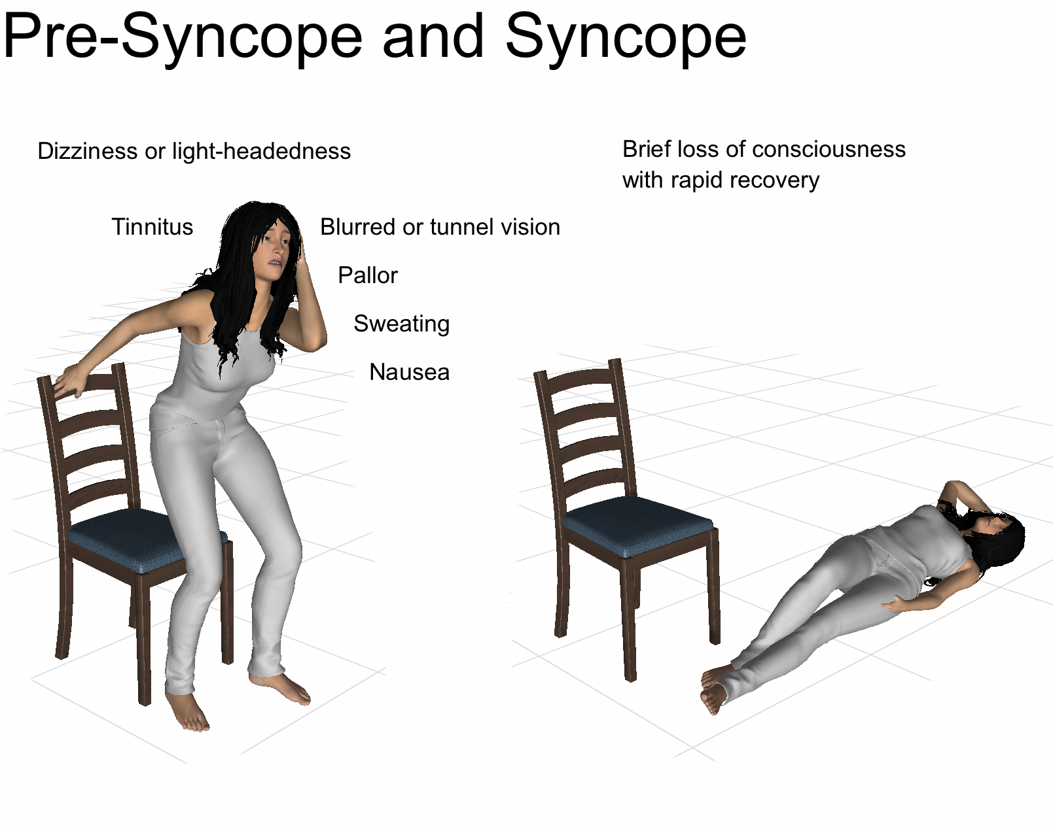

Slide 24
Features of MCA and ICA Large Vessel Occlusion (LVO)
Left MCA/ICA stroke
Aphasia = acquired loss of language function
Impaired speech production and/or comprehension
Impaired naming and repetition are common
Eye deviation to the left side with impaired gaze to the right (weak) side
Loss of vision and/or neglect of the right side
Right-sided weakness
Right MCA/ICA stroke
Eye deviation to the right side with impaired gaze to the left (weak) side
Loss of vision to the left side
Prominent neglect including failure to recognize the left side of the body or that they are having stroke symptoms
Left-sided weakness

Slide 25
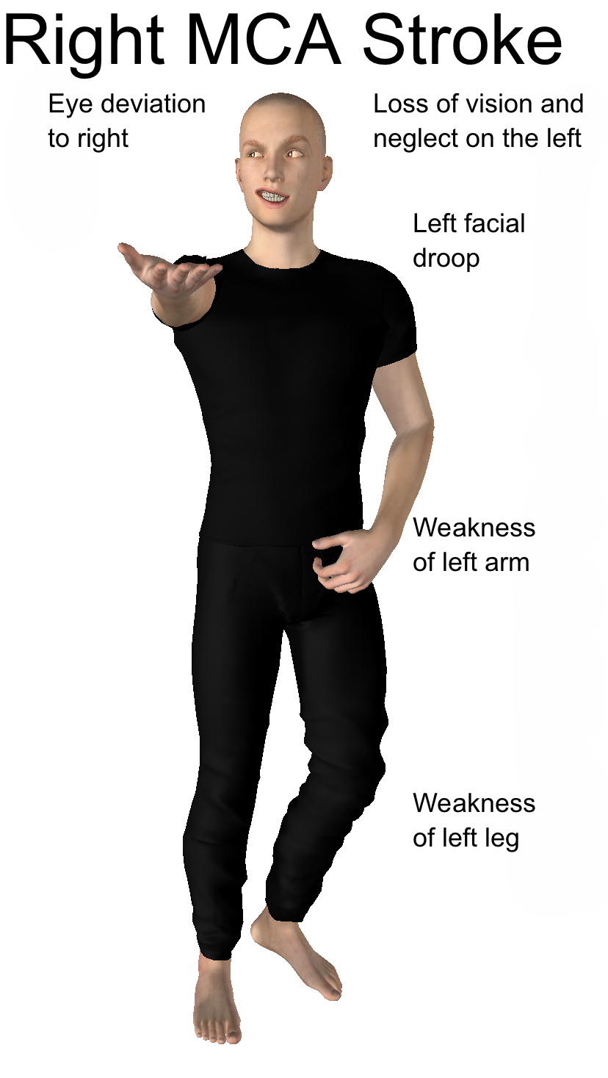
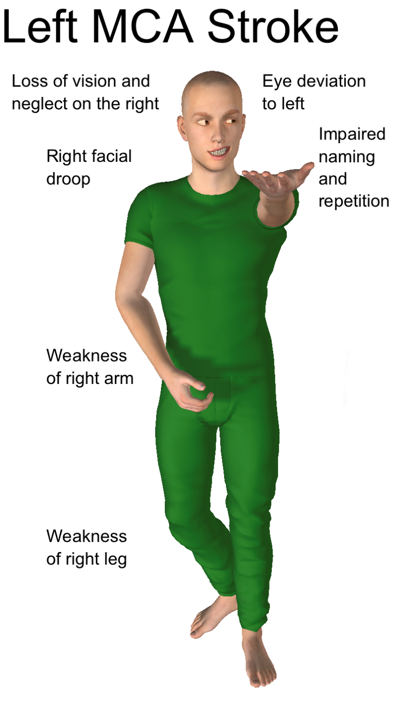

Slide 26
Emergency Medical Stroke Assessment (EMSA)
 |  | Abnormal?
E: Eye Movement
 | Horizontal Gaze Ask patient to keep their head still and follow your finger left to right with their eyes In aphasic patients, call the patient’s name on one side and then the other Abnormal: Patient is unable to follow as well in one direction compared to the other | ☐
M: Motor – Asymmetric Face, Arm, or Leg Weakness
 | Facial Weakness Ask patient to show their teeth or smile In aphasic patients, look for asymmetric grimace to pain Abnormal: One side of the face does not move as well as the other | ☐
 | Arm Weakness Ask patient to hold out both arms, palms up, for 10 seconds with eyes closed In aphasic patients, hold the patients arms up and let go Abnormal: One arm does not move or drifts down compared to the other | ☐
 | Leg Weakness Ask patient to lift up one leg and then the other for 5 seconds In aphasic patients, hold up one leg and let go, then repeat on the other side Abnormal: One leg does not move or drifts down compared to the other | ☐
SA: Slurred Speech or Aphasia
 | Naming Ask patient to name your watch and pen Abnormal: Patient slurs words, says the wrong words, or is unable to speak | ☐
 | Repetition Ask patient to repeat “They heard him speak on the radio last night” after you Abnormal: Patient slurs words, says the wrong words, or is unable to speak | ☐

Slide 27
Concept of Last Known Well
Time Last known well (LKW) is part of how we determine if a patient is eligible for t-PA (< 4.5 hours) or thrombectomy (< 24 hours)
Time LKW will be a critical part of your triage decision after implementation of SBST
A reliably-witnessed onset time = time LKW
If onset not reliably witnessed, time LKW = when the patient was last seen at their baseline level of neurologic function

Slide 28
Concept of Last Known Well
LKW = onset time when symptoms are first observed when a patient can reliably self-report or if onset is witnessed by someone else
Wife sees husband suddenly stop speaking during breakfast at 7 AM
Witnessed onset = time LKW = 7 AM
Patient without aphasia or neglect reports sudden onset of right-sided weakness at 2 PM while at work
Reliably self-reported onset = time LKW = 2 PM

Slide 29
Concept of Last Known Well
If not reliably witnessed, time LKW = when the patient was last seen at their baseline level of neurologic function
After returning home from work at 6 PM, wife finds husband on kitchen floor with confusion and left-sided weakness. He was last seen to be OK at 8 AM after breakfast before she went to work
Time LKW = 8 AM
Patient reports that she had left-sided weakness on awakening at 6 AM. She was in her usual state of health when she went to bed at 11 PM
Time LKW = 11 PM

Slide 30
Thank You!
Kent Wilson, BS, AAS, NRP Stroke and Cardiac Systems Coordinator Alabama Department of Public Health Office of Emergency Medical Services Administrative Annex 208 Legends Court P.O. Box 303017 Prattville, AL 36066 Office: 334-290-3088 Fax: 334-206-0364
kent.wilson@adph.state.al.us
Toby Ira Gropen, MD, FAHA | James H. Halsey Jr., MD Endowed Professor Chief, Division of Cerebrovascular Disease/Department of Neurology Director, Comprehensive Neurovascular and Stroke Center UAB | The University of Alabama at Birmingham RWUH M226 | 619 19th St S | Birmingham, AL 35249-3280 Office: 205-975-7516
tgropen@uabmc.edu

