Slide 1
Alabama Trauma/Stroke System
Rescue Stop
Accelerated Transfer
ATCC MCI Coordination
ATCC Operations
“Real-time EMS”

Slide 2
RESCUE STOP – TRAUMA WHY, WHEN, HOW?
Why?
To allow for life-saving procedures, unable to be completed by EMS, to be completed at a hospital emergency department without a full evaluation/workup, thus allowing patient transport to rapidly continue to the appropriate level trauma center.

Slide 3
RESCUE STOP – TRAUMA WHY, WHEN, HOW?
When?
In the following situations, the patient should be transported IMMEDIATELY to the closest hospital with full time emergency physician coverage (trauma center preferably) as coordinated by the ATCC.
The EMSP is unable to effectively manage the airway or ventilate the unstable patient.
The EMSP is unable to stop the bleeding of a patient with severe external hemorrhage.
The EMSP is unable to establish/maintain an IV/IO to provide volume resuscitation in an unstable hypovolemic patient.

Slide 4
RESCUE STOP – TRAUMA WHY, WHEN, HOW?
How?
Hospital transfer to an adult or pediatric specialty center can proceed as soon as the patient is stable enough for transport (not necessarily full and complete resuscitation or evaluation/initial care). For expediency (time savings), data collection purposes, and adherence to ATS standards, OEMS prefers that hospital transfers be directed by the ATCC.

Slide 5
ACCELERATED TRANSFER –TRAUMA WHY, WHEN, HOW?
Why?
To allow for the ACCELERATED TRANSFER of a trauma system patient arriving by POV or by EMS (undertriaged), to the appropriate level trauma center (without verbal acceptance of the trauma center) based on trauma center availability as displayed in LifeTrac.

Slide 6
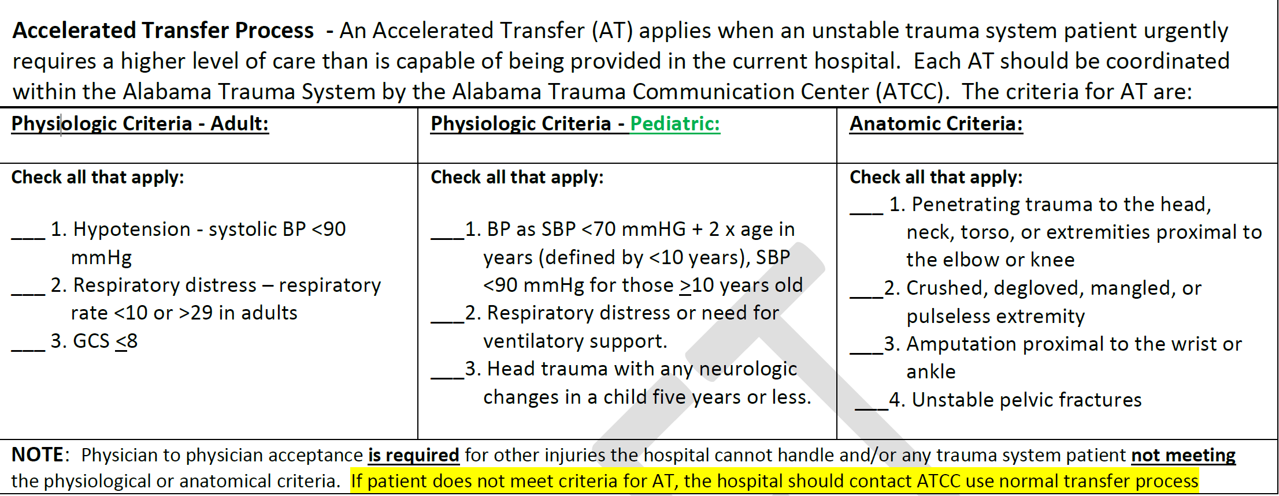
ACCELERATED TRANSFER –TRAUMA WHEN?

Slide 7
ACCELERATED TRANSFER –TRAUMA WHY, WHEN, HOW?
How?
Hospital transfer to an adult or pediatric specialty center can proceed as soon as the patient is stable enough for transport (not necessarily full and complete resuscitation or evaluation/initial care). For expediency (time savings), data collection purposes, and adherence to ATS standards, OEMS prefers that hospital transfers be directed by the ATCC.

Slide 8
Next Steps/Keys to Success
Adoption of AT at STHSAC on Monday, March 13
Education roll-out to ALL hospitals and EMSP for both Rescue Stop and Accelerated Transfer.
Set go-live date (ADPH OEMS AHS)
Education, education, education
Allow the system to work
Follow the plans and procedures
Don’t go rogue
Review and QI on every RS/AT patient
System adjustments as needed

Slide 9
Comments/Input

Slide 10
ATCC MCI Coordination
Centralized coordination of patient hospital destination based on resource availability when local resources are overwhelmed
Relieves on-scene personnel of hospital coordination
Attempts to prevent overloading of hospital(s) or if overloading occurs; transfer plan or alternative care plan for rapid offloading

Slide 11
MCI Keys to Success
State-wide or region-wide master plan incorporated into local plans
Build MCI on the backbone of system used in normal course of business, such as the Alabama Trauma System
Regular exercises if no recent real-world events
Early declaration with estimated patient numbers and types of patients
ATCC notifies hospitals and gets estimated pt capacity
ATCC notifies outside EMS resources through pre-planned methods
Limit rogue decisions by individual EMSP/ambulances
Consideration of hospital walk-ins
Consideration of regular calls and other events

Slide 12
MCI – Current Practices
BREMSS – All MCI pts. coordinated through ATCC
1998 F5 Tornado – 189 pts in two hours
Other tornado events
Numerous bus crashes with 100 – 200 pts
Chemical release at B’ham Water – 54 pts in 2 hours
Other regions – Sporadic MCI pt. coordination using ATCC
Gulf – Anhydrous ammonia leak - ~100 pts - 2010
Mostly trauma system pt entries
Gulf – Bus crash – 60 pts.
Southeast – South Montgomery Co.- 10 pt. van crash
Lee Co. – March 2019

Slide 13
Lee Co. Tornado – March 3, 2019 ATCC Data
15:26: First notification and first pt entered.
15:26: EAMC reported 8 walk-ins
ATCC called closest hospitals for capacity #s
EAMC - 10 more
Piedmont – 8
St. Francis – 10
Baptist South – 4
EAMC reported multiple patients and multiple codes
18:05: SAMC, Flowers, Baptist South, UAB, COA notified of need for transfers from EAMC

Slide 14
Lee Co. Tornado – March 3, 2019 ATCC Data
Pts entered into ATS
EMS – 10
EAMC – 5
Jack Hughston – 2
Piedmont Columbus – 3
Hospital – 5
Transfers to:
UAB – 3
SAMC – 1
COA – 1 (expired before transferred)
2 other nearby MVCs with trauma system entries during the MCI

Slide 15
Future of MCI in Alabama
Integration of MCI Coordination as a function of ATCC within the Alabama Trauma System
State-wide plan to allow for regional/local resources and challenges.
Identification/Inclusion of any resources that would normally be used in an MCI (real-world plans).
Standardization of triage methods and terminologies. (ADPH OEMS Current Protocols)

Slide 16
Comments/Input

Slide 17
Comments/Input
ATCC Operations
“Why do they ask so many questions when we call?”
“Why don’t they ever recommend “that” hospital?”
“Why do they ever recommend “that” hospital?”

