Slide 1
10th Edition Patient Care Protocol Update
Notes:
Introduction
Classroom etiquette
Bathroom
Refreshments

Slide 2
Program Objectives
Discuss what a guideline is & is not
Discuss “Scope of Practice”
Compare the Format of the “Old” to the “New”
Review EMSP Level abbreviations
Review medication changes

Slide 3
Program Objectives
Practice medication preparation and administration
Discuss Cat A versus Cat B
Review EMSA
Review New ADPH Rule Changes
Complete Scenario Lab

Slide 4
Guidelines
A guideline is a general rule, principle, or piece of advice.
EMS protocols are soft boundaries
EMS protocols are not rigid boundaries
Notes:
Reinforce the fact that guidelines are flexible, allowing each EMSP discretionary decision making. As important as it is to know the protocols, each EMSP should embrace the use of protocols on scene and thinking out of the box.

Slide 5
Ems protocols “guidelines”
Protocols are intended to guide emergency medical services personnel (EMSP) in the response and management of emergency situations and the care and treatment of patients.
We must use our Knowledge, Skills, and Abilities in conjunction with the EMS Protocols!
We, the EMSP, are responsible for our actions or lack of actions.
Notes:
We promote EMSP decision making; however, each EMSP is responsible for those decisions.

Slide 6
What is a policy
A set of guidelines or rules that determine a course of action.
EMS policies are rigid boundaries
EMS policies are not soft boundaries
Policies are inherent to an Agencies Administrative/Management Staff
Notes:
Use the mandatory versus optional to illustrate a policy
Reference the ADPH Rules
Reinforce the fact that administrative staff refer to policies more often than operational staff

Slide 7
Scope of practice
Clearly defined levels of skills and roles allowed for each level of emergency medical services personnel

Slide 8
Scope of practice
Each EMSP is responsible for their Scope of Practice
OLMD request
EMSP request
Use Knowledge, Skills, and Abilities to know when to DECLINE
Notes:
Reinforce the fact that all EMSPs are responsible for treating within their respective scope of practice.
If they step out, they are personally responsible
If they accept an order from OLMD that is beyond their scope, the EMSP is personally responsible
If they request and get approval outside their scope, they are responsible

Slide 9
Scope of practice…pit falls
“I learned this in paramedic school”
AEMT assisting a Paramedic…
Your individual Scope of Practice can be found in the front of the EMS Protocols
Notes:
Use subcutaneous administration of insulin to illustrate a medication learned but not within our scope.
If the lower level EMSP accepts an order from a higher level EMSP, they are both responsible; however, supporting higher level EMSPs using a strong team dynamic is encouraged.

Slide 10
Format change
Replaced paragraph style with algorithm style
Added EMSP level abbreviations
E – EMT
A – Advanced EMT
I – Intermediate EMT
P – Paramedic
C – Critical Care Paramedic

Slide 11
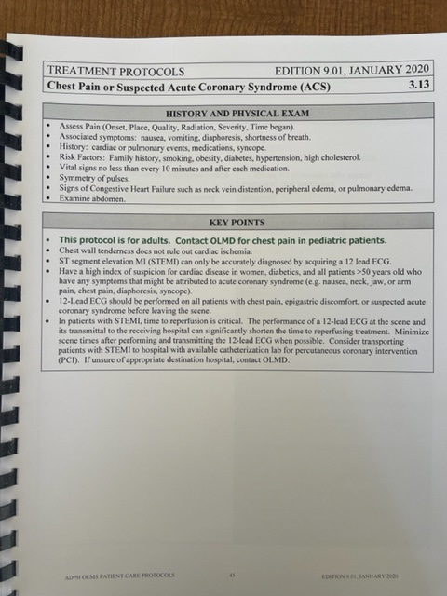
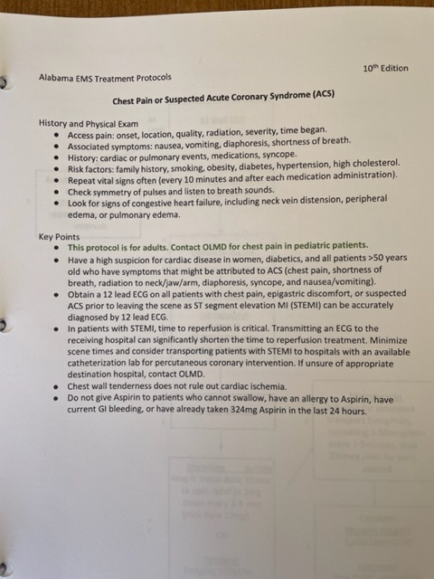

Slide 12
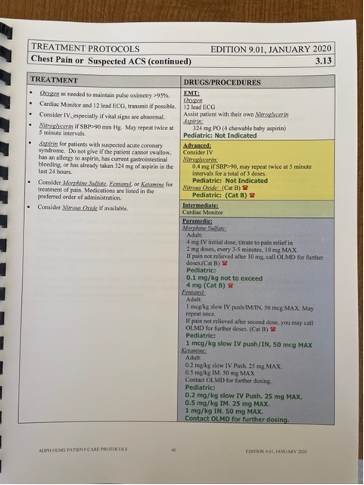
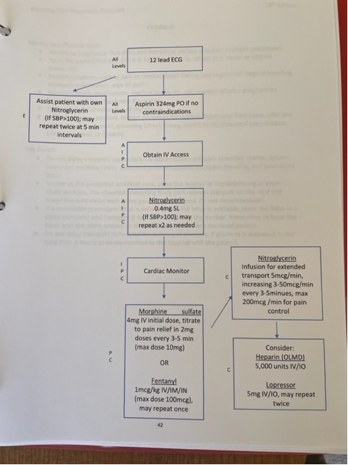
Notes:
Point out the EMSP level abbreviations.
Reinforce their similarities and identify their differences:
Must be knowledgeable of the “Why” you are providing medications or procedures

Slide 13
Medication additions & changes

Slide 14
EMT
Acetaminophen (Tylenol)
Nebulized Albuterol
Notes:
Review the pain management protocol to illustrate acetaminophen.
Review the allergic reaction protocol to illustrate nebulized albuterol

Slide 15
Skill Time
Prepare:
Acetaminophen
Albuterol Nebulizer
Administer (explain):
Nebulized Albuterol
This Photo by Unknown Author is licensed under CC BY-NC-ND

Slide 16
Advanced/intermediate EMT (Continued)
Epinephrine (1:10,000)
Methylprednisolone (Solu-Medrol)
Midazolam (Versed)
Ketorolac (Toradol)
Rocephin (Cetriaxone) (Optional)
Tranexamic Acid (TXA) (Optional)
Notes:
Review cardiac arrest for EPI
Review adrenal insufficiency and respiratory distress protocol for Solu-Medrol
Review seizure protocol for Versed
Pain for Toradol
Sepsis and open Fx for Rocephin
Hemorrhage for TXA

Slide 17
Drip rate FORMULA (TXA)
VOLUME x drip factor
Time in Minutes
= gtts/min
Step 1
Step 2
Step 3
Step 4
Step 5
Vol-100 ml
Time-20min
gtt/set-10
100ml x 10
20
100ml x 10
20
5ml x 10
1
50
1
50gtts/min
Notes:
Discuss how the drip rate is determined for TXA
Mix 2g in 100mL (NS, D5W, or LR) and administer by IV flow regulator or pump infusion (600mL/hr) over 10 minutes.

Slide 18
Skill Time
Prepare:
Epi 1:10,000 & from Epi 1:1,000
Toradol
Rocephin
Solu-Medrol
TXA
Versed
Administer (explain):
Versed via nasal atomizer
TXA via pump, dial-a-flow, or metronome

Slide 19
Paramedic
3% Saline
Norepinephrine (Levophed)
Notes:
Review the General Trauma protocol for 3% saline
Review sepsis or shock for Levophed

Slide 20
Skill Time
Prepare:
Levophed (norepinephrine)
Administer:
Levophed
Notes:
Mix 4 mg of Norepinephrine in 250 ml of D5W = 16 mcg/ml concentration
Use chart on page 112 of protocols for administration

Slide 21
Category A & Category B
Category A
Category B
All Medications
Almost All Procedures
Intubation of a patient that is three (3) years or younger
Notes:
All medication are category A
There are recommendations to contact OLMD within the flow charts; these are recommendations only, not Cat B requirements. Encourage your class to consult OLMD anytime they are unsure…that is what they are there for!
All procedure except infant intubation is category A
There are recommendations to contact OLMD within the flow charts; these are recommendations only, not Cat B requirements. Encourage your class to consult OLMD anytime they are unsure…that is what they are there for!

Slide 22
Consultation with OLMD
When you see “Contact OLMD” without a red phone
You are strongly encouraged to consult the physician prior to performing or administering that item!
Remember…OLMD is there to HELP!
Notes:
Just reinforce the use of OLMD…they are there to assist.

Slide 23
Emsa review
Go Live is April 1, 2022!
EMSA Stroke Scale and Respiratory Emergencies Aug 25 2021 - YouTube
Notes:
Discuss the importance of entering patients that exhibit stroke S/S and lighten up the EMSP discretion entries…we are clogging the system with a statewide average of 48% positives and 52% other (metabolic, toxin, etc.)
ATCC is preparing to route those patients showing S/S of LVO to a facility that offers thrombectomies
An EMSA score > 3 is likely a LVO

Slide 24
Alabama EMS rule change (optional)
Notes:
Bullets provided…optional to discuss

Slide 25
Summary
The redesigned protocols are fundamental the same…
Fresh look…
Some new medications…
Big shift towards universal Cat-A system
EMSA…coming to an incident near you
ADPH Rule Changes

Slide 26
Notes:
Questions

