Slide 1
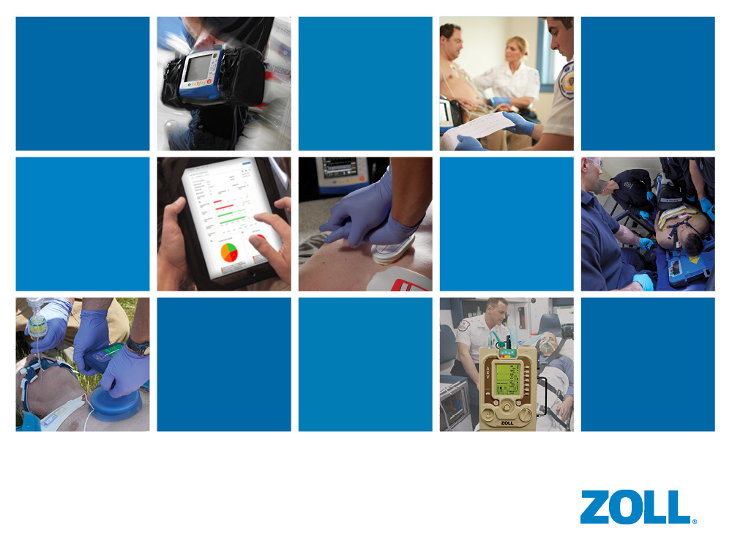
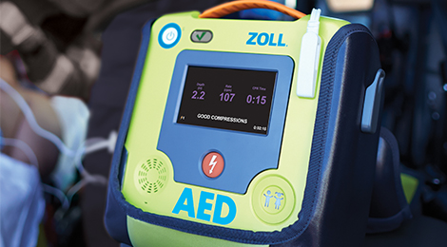
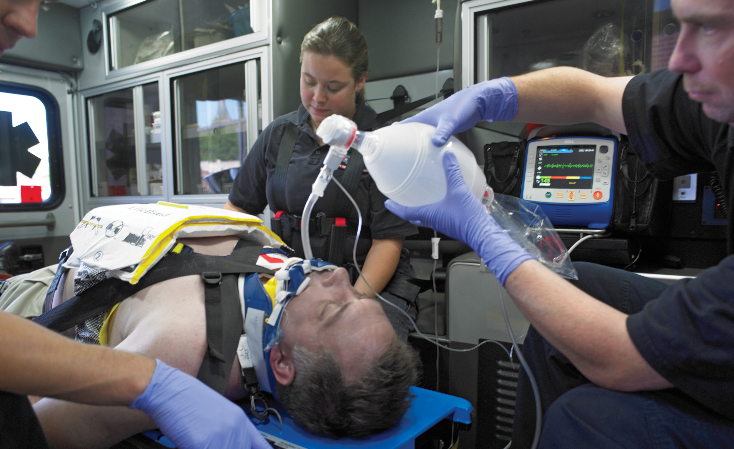
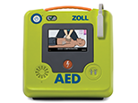
EMS Clinical
Deployment
Services
Katie Talk NRP
ktalk@zoll.com
AED 3 In-Service Training
Notes:
Hi everybody I’m_____________ from ZOLL, and I’m here to show you the new ZOLL AED 3 Monitor/Defibrillator. The AED is extremely small, extremely light and extremely powerful in every dimension. And it has unequalled data capture, transmission and access capabilities. It’s everything you could ever need or want in an AED defibrillator…without compromise.
Action: Hold AED 3 and Turn on and off

Slide 2

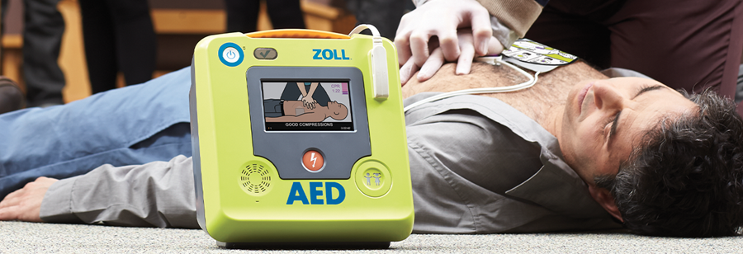

This Photo by Unknown Author is licensed under CC BY-SA
AED 3
Each department should bring AED with battery and pads and a USB drive.
John Blue
President & CEO
EAST ALABAMA EMS, INC
Notes:
Thank you to the State of Alabama and particularly John Blue and his staff for making this possible.
Thanks, also to GORESCUE for their commitment in this implantation and deployment of the AEDs

Slide 3
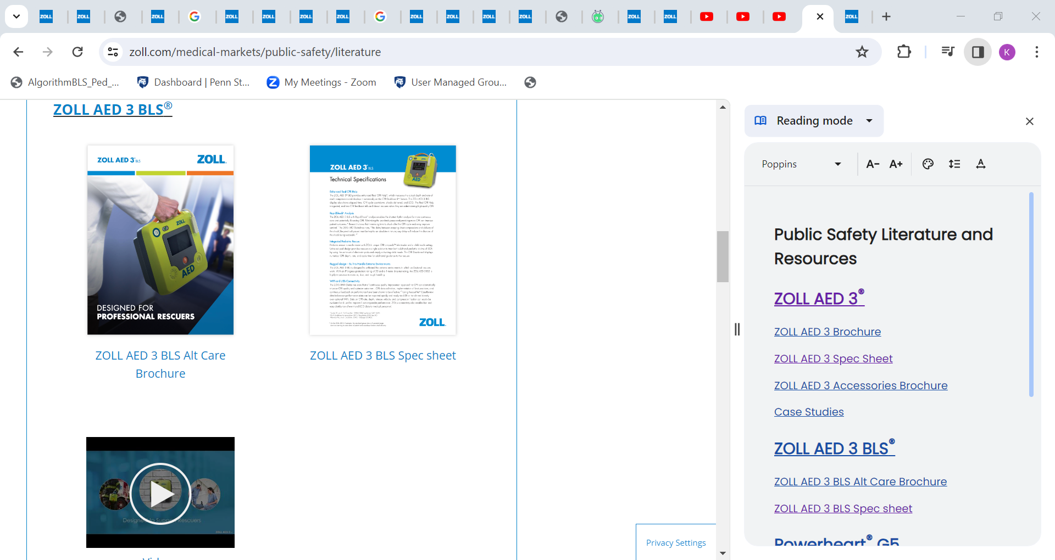
Tap AED 3 for
SPEC Sheet
https://www.zoll.com/medical-markets/public-safety/literature
Notes:
SPEC SHEET LINK – touch AED

Slide 4
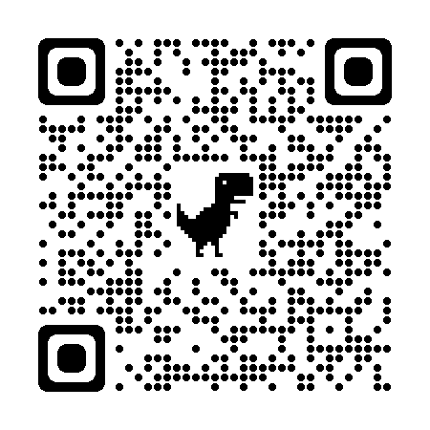
AED
Press the On/Off button to turn on the defibrillator and follow the voice prompts
Place defibrillation pads on the patient (follow the defibrillator’s voice prompts)
Shock patient
Start CPR
CPR feedback
Show AED “No shock advised” guidance
Turn off AED
Notes:
AED BLS Video LINK Touch AED

Slide 5
Demo
- (With battery removed) Demonstrate status window.
- (Insert battery) Demonstrate status window and self test.
• Self test performed weekly
- Make sure the defibrillation pads are always connected to the defibrillator and the battery is
installed.

Slide 6
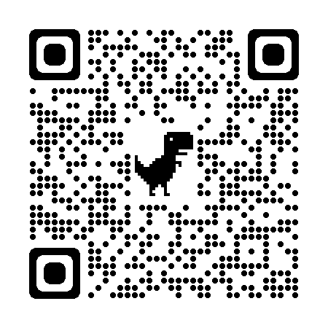
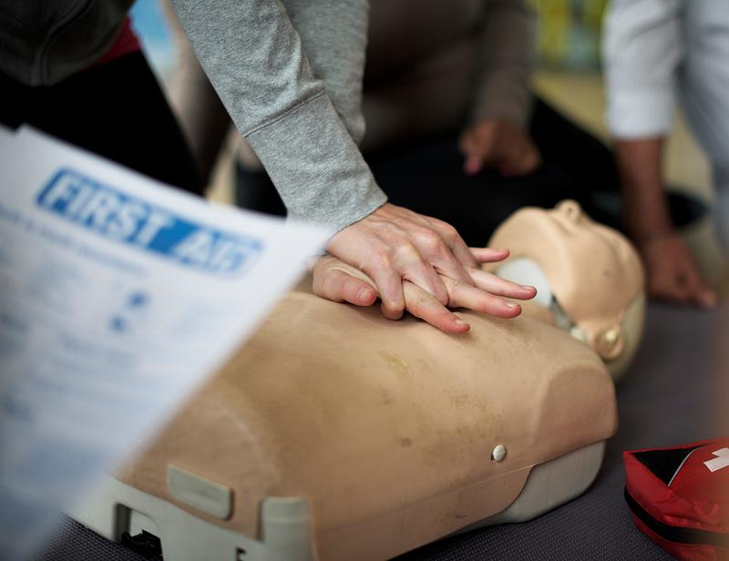
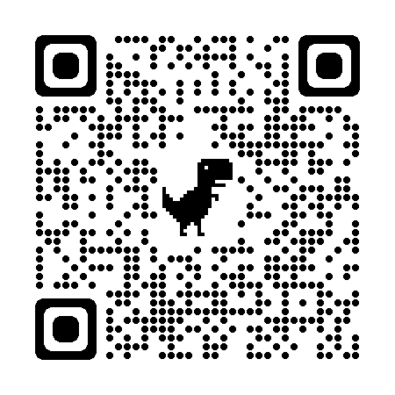
Notes:
Demo CPR with AED
Hey, you ok?
Assess unresponsive, not breathing, no pulse/ signs of life
Someone call 911
Someone get AED
Remove Shirt
Begin CPR
Turn on AED and follow prompts

Slide 7
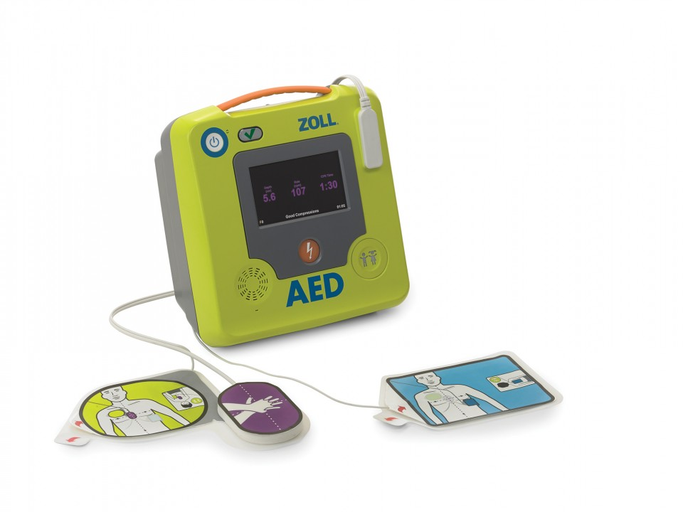
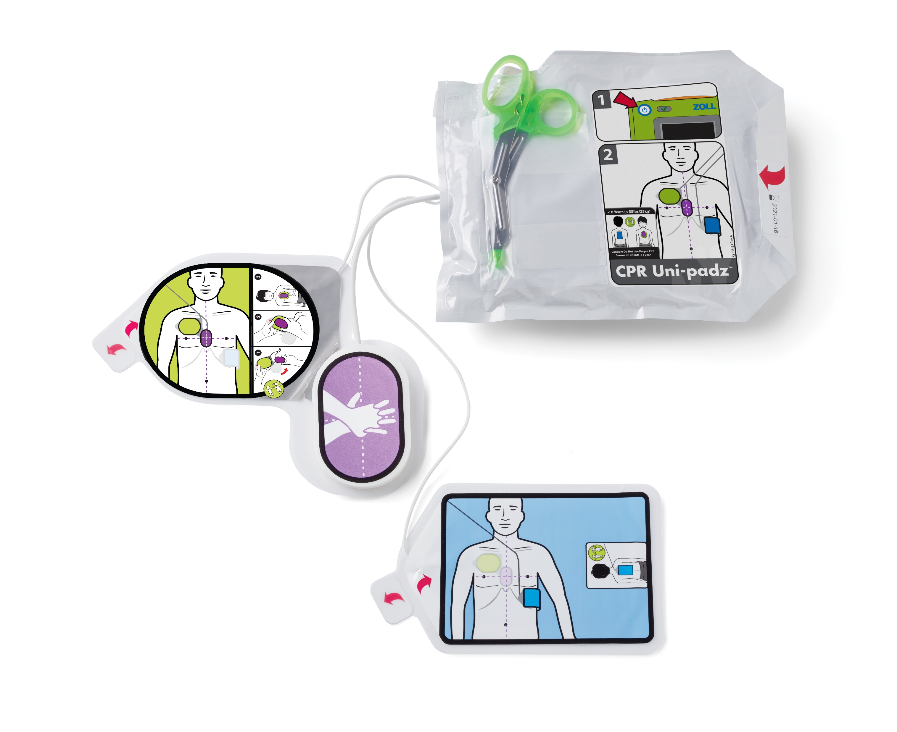
Show Adult and Pedi pads / Uni-Padz
AED patient mode changes to Pediatric when using Uni-Padz
ACCESSORY LINK
This Photo by Unknown Author is licensed under CC BY
Pediatric pads should be used on children under 8 years old or children who weigh less than 55 pounds. Adult pads can be used on children and people 8 years old or older or weigh more than 55 pounds.
Notes:
Demo PADS
IF EMS present- discuss STATPADZ

Slide 8
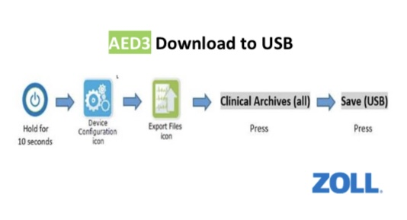
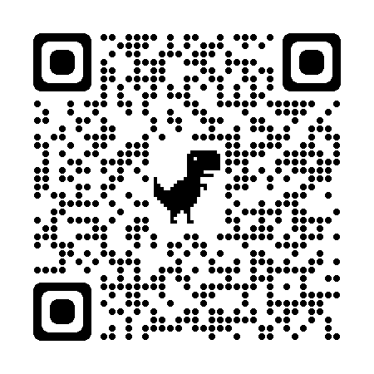
* data transfer:
Place AED in Management Mode
Select Device Configuration icon
Select Export Files icon
Select “Clinical Archives (all)
Select Send (Wi-Fi) / USB
- Power unit off.
Notes:
Transfer of report to rescuenet by wifi or usb

Slide 9
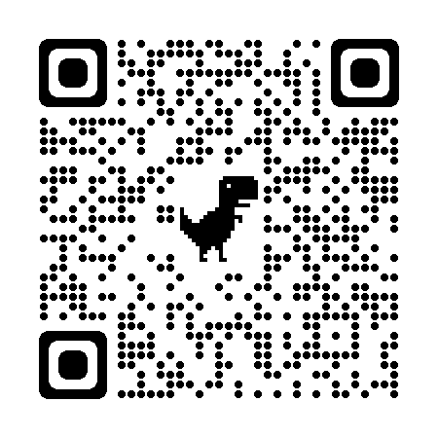
RescueNet Event Summary
Notes:
Show rescuenet summary

Slide 10
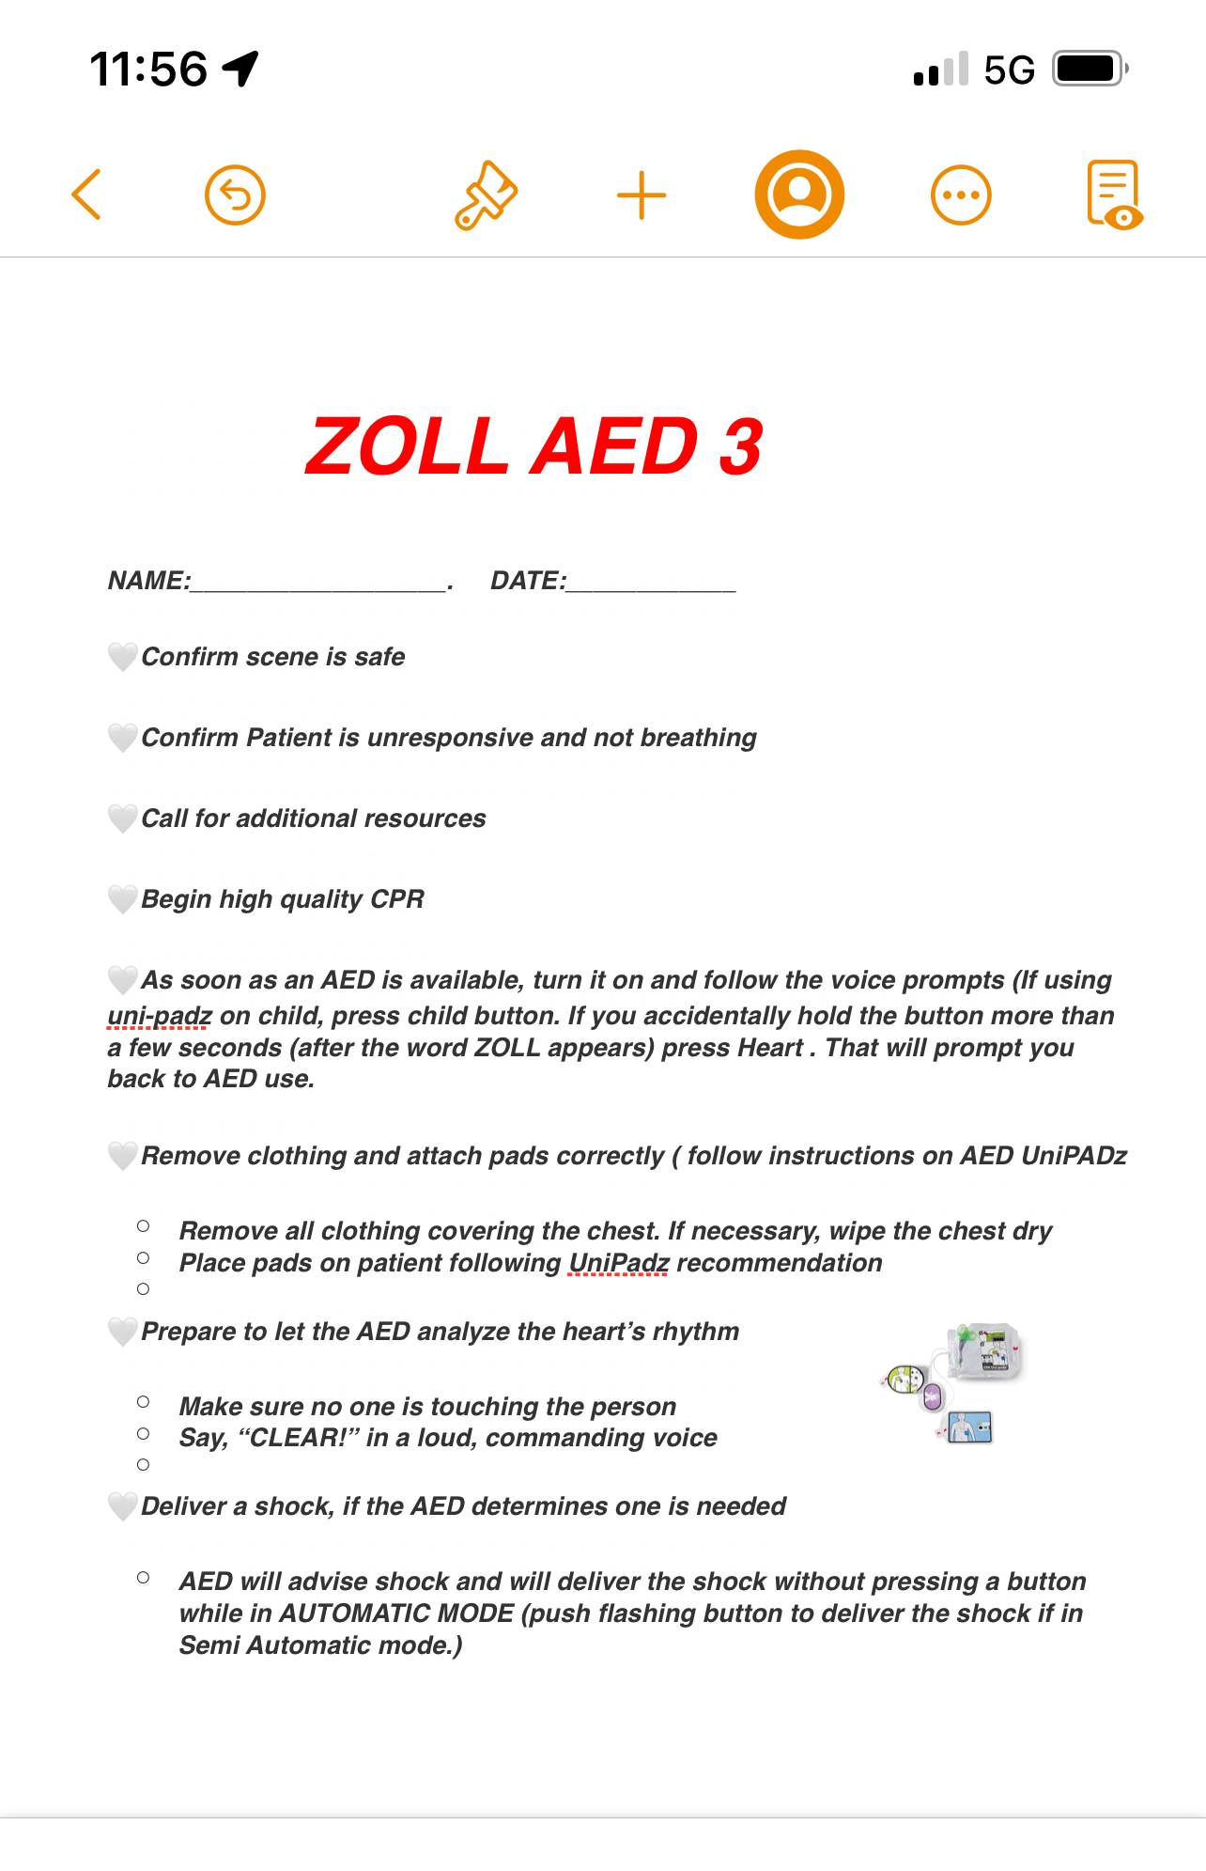
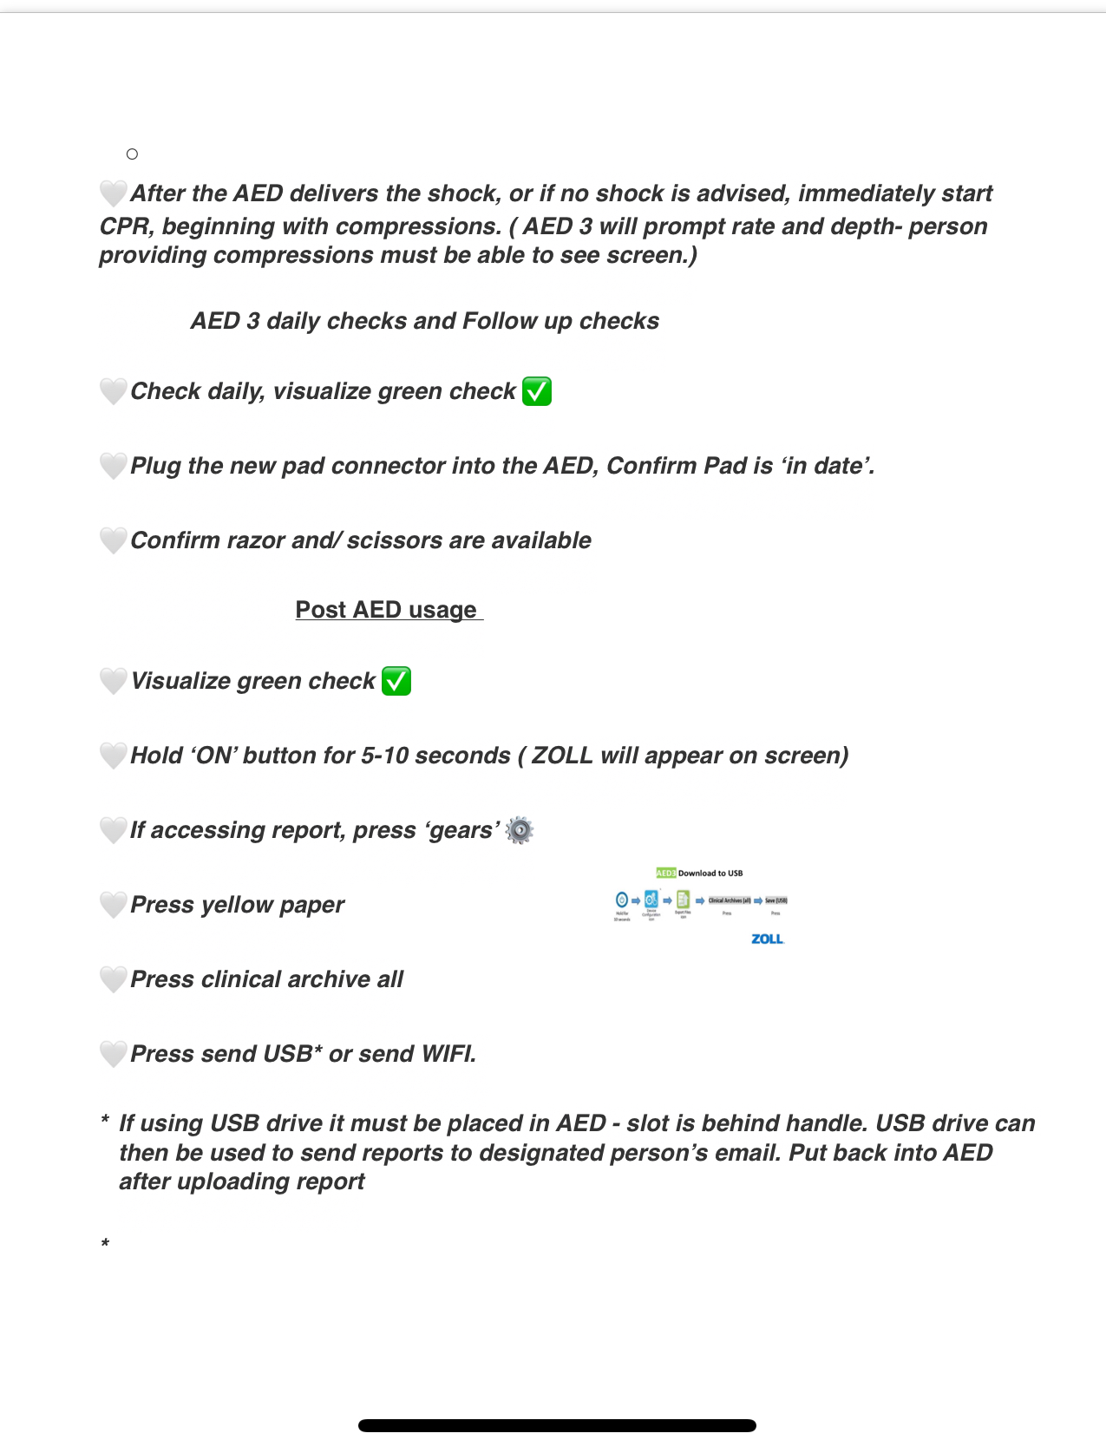
Notes:
Checklist for AED training

Slide 11
DISCUSS ADMINISTRATORS SET UP
Configuration of AED / INPUTTING DEPARTMENT INFO and configuring multiple AEDs
RESCUENET SETUP FOR EACH DEPARTMENT
Configuration for AED 3 archive transfer
2401230159047 password 123456
Self test Sunday 2 am
Name device wifi will be specific to each department
AED ADMIN
Notes:
ADMINistrator SET UP

Slide 12
Plustrac https://app.plustrac.com/
ADMIN
MANUAL
PG 65

Slide 13
Questions?

Slide 14

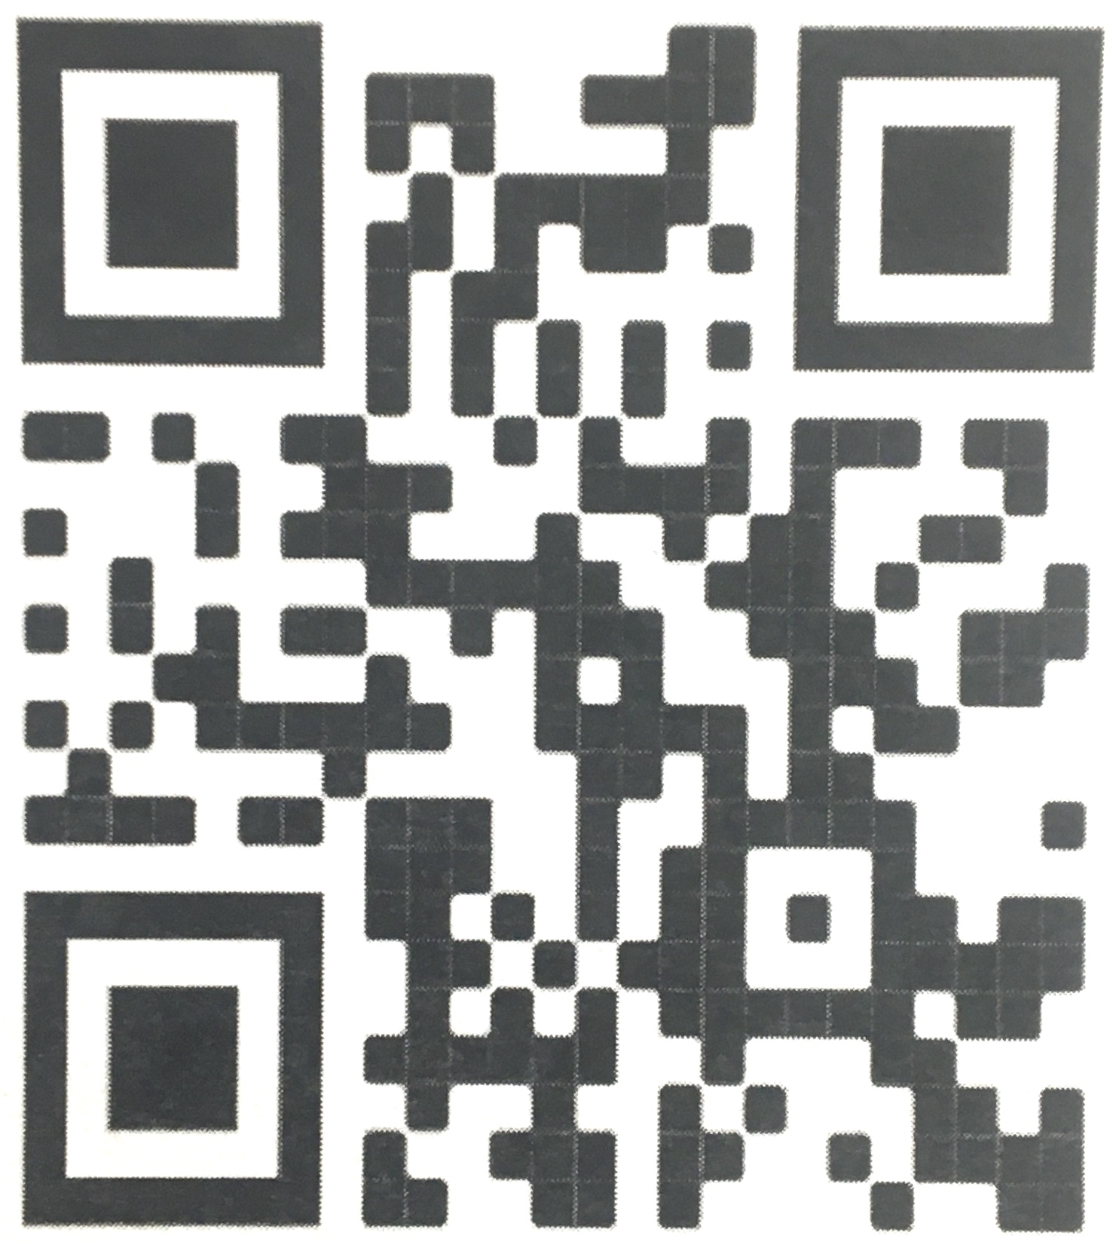
EMS CLINICAL DEPLOYMENT TEAM
Thank you for attending today’s training.
Please take a moment to fill out our survey:
zollcdssurvey.com
Katie Talk
ktalk@zoll.com

